Slide 1
Department of Computer Science and Engineering (CSE)
INSTITUTE : UIE
DEPARTMENT : CSE
Bachelor of Engineering (Computer Science & Engineering)
Disruptive Technologies-3
(23CSH-203)
Overview of Databases
DISCOVER . LEARN . EMPOWER

Slide 2
Department of Computer Science and Engineering (CSE)
COURSE OBJECTIVES:
The course aims to provide exposure to understand Information Security basics like Operating System Security, Network Security, Software Security and Web Security.
The course aims to provide basics of cloud computing along with virtualization, cloud computing is one of the fastest growing domains from a while now. It will provide the students basic understanding about cloud and virtualization along with it how one can migrate over it
The Course aim to state core blockchain concepts, the benefits, and the limitations of blockchain technologies

Slide 3
Department of Computer Science and Engineering (CSE)
CO No | Statement
CO1 | Remember the concepts related to fundamentals of Information Security, Cloud Computing and Block Chain.
CO2 | Understand the way to find, understand and Analyse the Problem for Errors, Attack memory Virtualization and Basic Block chain Techniques.
CO3 | Apply various method to avoid Security Leakage, Data Storage on cloud and working methods of Block Chain.
CO4 | Analyse the Basic tools of Information Security, Cloud Computing and Blockchain and implementation with reports generation.
CO5 | Design and develop customized reports on attacks, Online memory allocation , security using blockchain

Slide 4
Contents of the Syllabus
Department of Computer Science and Engineering (CSE)
UNIT-1 | INTRODUCTION TO BASIC OF INFORMATION SECURITY | Contact Hours:10
Introduction to Security, Attacks and its Understanding | Introduction Security, Attacks, Computer Crime, Security Services, Security Mechanism, Cyber Crime, Information Technology ACT.
Fundamental of Ciphers | Cryptography, Substitution Ciphers, Transpositions Ciphers, Block Ciphers, Stream Ciphers,
Precautions and Preventions of Cyber Crime. | Cyber Crimes, Types of Cyber Crime, Social Media Precautions, Prevention of Cyber Crime and Basic precautions. Basic of Ethical Hacking.
UNIT-2 | CLOUD COMPUTING AND DATA VIRTUALIZATION |  | Contact Hours:10
Cloud Computing Overview | Origins of Cloud computing – Cloud components - Essential characteristics – On-demand selfservice, Broad network access, Location independent resource pooling ,Rapid elasticity , Measured service, Comparing cloud providers with traditional IT service providers, Roots of cloud computing
Cloud Insights | Architectural influences – High-performance computing, Utility and Enterprise grid computing, Cloud scenarios – Benefits: scalability, simplicity, vendors, security, Limitations – Sensitive information
Cloud Applications | Application development- security level of third party - security benefits, Regularity issues: Government policies

Slide 5
Contents of the Syllabus
Department of Computer Science and Engineering (CSE)
UNIT-3 | BLOCK CHAIN AND CRYPTOCURRENCY
Introduction to Block Chain and Cryptocurrency | Blockchain Overview History and Origin of Blockchain (and Cryptocurrency) Start of Technical Concepts of Blockchain Systems, Importance, Applications, Benefits and features of Block Chain Technology.
Components and Working of Block Chain | Key component and working of Block Chain Technology, Types of Block Chain Networks and protocols
Bitcoin and block Chain. | Bitcoin network, Bitcoin Mining, Differentiate between database, cloud and Blockchain, Block Chain Services, Introduction to AWS server and Virtual Machines

Slide 6
Block cipher
Department of Computer Science and Engineering (CSE)
Block cipher is an encryption and decryption method which operates on the blocks of plain text, instead of operating on each bit of plain text separately. Each block is of equal size and has fixed no of bits. The generated ciphertext has blocks equal to the number of blocks in plaintext and also has the same number of bits in each block as of plain text. Block cipher uses the same key for encryption and decryption.
Block Cipher Principles
A block cipher is designed by considering its three critical aspects which are listed as below:
Number of Rounds
Design of Function F
Key Schedule Algorithm
University Institute of Engineering (UIE

Slide 7
Block cipher
Department of Computer Science and Engineering (CSE)
1. Number of Rounds
The number of rounds judges the strength of the block cipher algorithm. It is considered that more is the number of rounds, difficult is for cryptanalysis to break the algorithm.
It is considered that even if the function F is relatively weak, the number of rounds would make the algorithm tough to break.
2. Design of Function F
The function F of the block cipher must be designed such that it must be impossible for any cryptanalysis to unscramble the substitution. The criterion that strengthens the function F is it non-linearity.
More the function F is nonlinear, more it would be difficult to crack it. Well, while designing the function F it should be confirmed that it has a good avalanche property which states that a change in one-bit of input must reflect the change in many bits of output.
The Function F should be designed such that it possesses a bit independence criterion which states that the output bits must change independently if there is any change in the input bit.
3. Key Schedule Algorithm
It is suggested that the key schedule should confirm the strict avalanche effect and bit independence criterion.

Slide 8
Block Cipher Modes of Operation
Department of Computer Science and Engineering (CSE)
There are five important block cipher modes of operation defined by NIST. These five modes of operation enhance the algorithm so that it can be adapted by a wide range of applications which uses block cipher for encryption.
Electronic Code Book Mode
Cipher Block Chaining Mode
Cipher Feedback Mode
Output Feedback Mode
Counter Mode

Slide 9
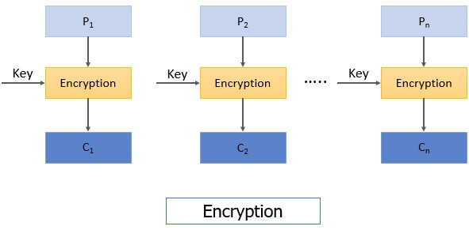
Block Cipher Modes of Operation
Department of Computer Science and Engineering (CSE)
1. Electronic Feedback Mode
This is considered to be the easiest block cipher mode of operation. In electronic codebook mode (ECB) the plain text is divided into the blocks, each of 64-bit. Each block is encrypted

Slide 10
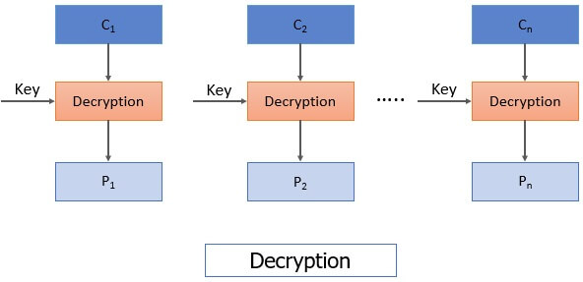
Block Cipher Modes of Operation
Department of Computer Science and Engineering (CSE)
When the receiver receives the message i.e. ciphertext. This ciphertext is again divided into blocks, each of 64-bit and each block is decrypted independently one at a time to obtain the corresponding plain text block. Here also the same key is used to decrypt each block which was used to encrypt each block. As the same key used to encrypt each block of plain text there arises an issue that for a repeating plain text block it would generate the same cipher and will ease the cryptanalysis to crack the algorithm. Hence, ECB is considered for encrypting the small messages which have a rare possibility of repeating text.

Slide 11
Cipher Block Chaining Mode
Department of Computer Science and Engineering (CSE)
To overcome the limitation of ECB i.e. the repeating block in plain text produces the same ciphertext, a new technique was required which is Cipher Block Chaining (CBC) Mode. CBC confirms that even if the plain text has repeating blocks its encryption won’t produce same cipher block.
To achieve totally different cipher blocks for two same plain text blocks chaining has been added to the block cipher. For this, the result obtained from the encryption of the first plain text block is fed to the encryption of the next plaintext box.
In this way, each ciphertext block obtained is dependent on its corresponding current plain text block input and all the previous plain text blocks. But during the encryption of first plain text block, no previous plain text block is available so a random block of text is generated called Initialization vector.

Slide 12
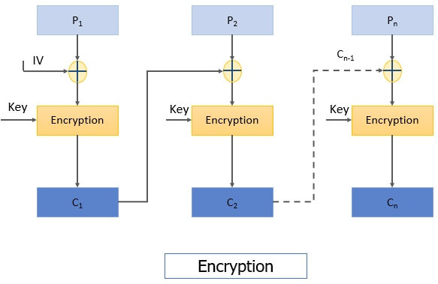
Department of Computer Science and Engineering (CSE)
Now let’s discuss the encryption steps of CBC
Step 1: The initialization vector and first plain text block are XORed and the result of XOR is then encrypted using the key to obtain the first ciphertext block.
Step 2: The first ciphertext block is fed to the encryption of the second plain text block. For the encryption of second plain text block, first ciphertext block and second plain text block is XORed and the result of XOR is encrypted using the same key in step 1 to obtain the second ciphertext block.
Similarly, the result of encryption of second plain text block i.e. the second ciphertext block is fed to the encryption of third plain text block to obtain third ciphertext block. And the process continues to obtain all the ciphertext blocks.
You can see the steps of CBC in the figure below:

Slide 13
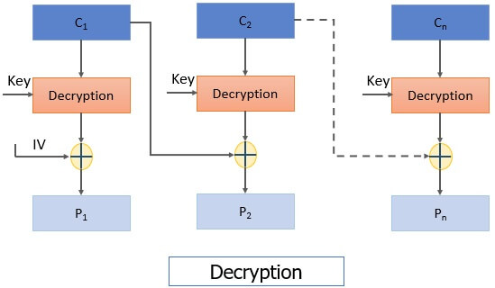
Department of Computer Science and Engineering (CSE)
Decryption steps of CBC:
Step 1: The first ciphertext block is decrypted using the same key that was used for encrypting all plain text blocks. The result of decryption is then XORed with the initialization vector (IV) to obtain the first plain text block.
Step 2: The second ciphertext block is decrypted and the result of decryption is XORed with the first ciphertext block to obtain the second plain text block. And the process continues till all plain text blocks are retrieved.

Slide 14
Cipher Feedback Mode
Department of Computer Science and Engineering (CSE)
All applications may not be designed to operate on the blocks of data, some may be character or bit-oriented. Cipher feedback mode is used to operate on smaller units than blocks.
Let us discuss the encryption steps in cipher feedback mode:
Step 1: Here also we use initialization vector, IV is kept in the shift register and it is encrypted using the key.
Step 2: The left most s bits of the encrypted IV is then XORed with the first fragment of the plain text of s bits. It produces the first ciphertext C1 of s bits.
Step 3: Now the shift register containing initialization vector performs left shift by s bits and s bits C1 replaces the rightmost s bits of the initialization vector.

Slide 15
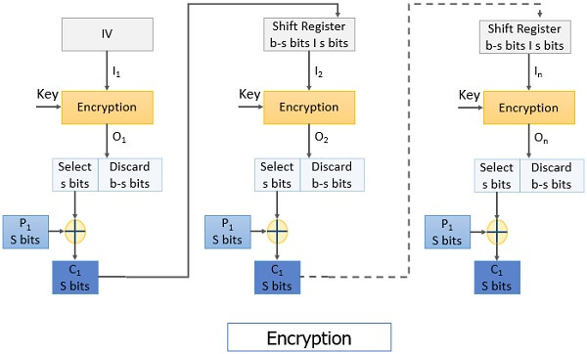
Department of Computer Science and Engineering (CSE)
Then again, the encryption is performed on IV and the leftmost s bit of encrypted IV is XORed with the second fragment of plain text to obtain s bit ciphertext C2.
The process continues to obtain all ciphertext fragments.

Slide 16
Decryption Steps:
Department of Computer Science and Engineering (CSE)
Step 1: The initialization vector is placed in the shift register. It is encrypted using the same key.
Keep a note that even in the decryption process the encryption algorithm is implemented instead of the decryption algorithm.
Then from the encrypted IV s bits are XORed with the s bits ciphertext C1 to retrieve s bits plain text P1.
Step 2: The IV in the shift register is left-shifted by s bits and the s bits C1 replaces the rightmost s bits of IV.
The process continues until all plain text fragments are retrieved.
It has a limitation that if there occur a bit error in any ciphertext C_{i} it would affect all the subsequent ciphertext units as C_{i} is fed to the encryption of next P_{i+1} to obtain C_{i+1}. In this way, bit error would propagate.

Slide 17
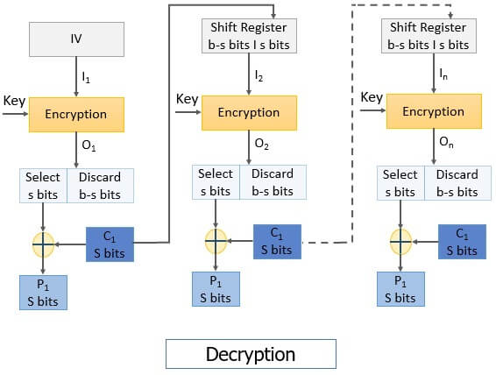
Department of Computer Science and Engineering (CSE)

Slide 18
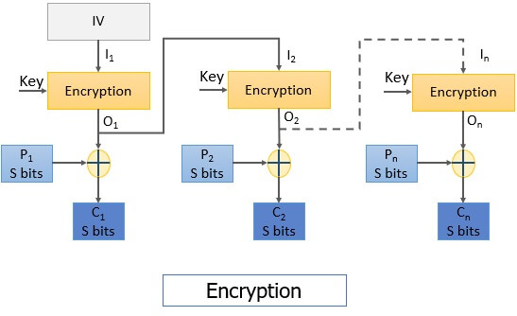
Department of Computer Science and Engineering (CSE)
Output Feedback Mode
The output feedback (OFB) mode is almost similar to the CFB. The difference between CFB and OFB is that unlike CFB, in OFB the encrypted IV is fed to the encryption of next plain text block. The other difference is that CFB operates on a stream of bits whereas OFB operates on the block of bits.
Steps for encryption:
Step 1: The initialization vector is encrypted using the key.
Step 2: The encrypted IV is then XORed with the plain text block to obtain the ciphertext block.
The encrypted IV is fed to the encryption of next plain text block as you can see in the image below.

Slide 19
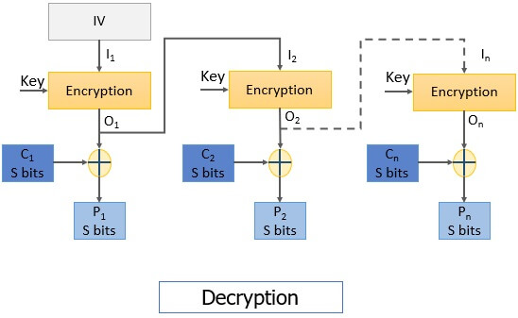
Steps for decryption:
Step 1: The initialization vector is encrypted using the same key used for encrypting all plain text blocks.
Note: In the decryption process also the encryption function is implemented.
Step2: The encrypted IV is then XORed with the ciphertext block to retrieve the plain text block.
The encrypted IV is also fed to the decryption process of the next ciphertext block.
The process continues until all the plain text blocks are retrieved.

Slide 20
Stream Ciphers
n stream cipher, one byte is encrypted at a time while in block cipher ~128 bits are encrypted at a time. Initially, a key(k) will be supplied as input to pseudorandom bit generator and then it produces a random 8-bit output which is treated as keystream. The resulted keystream will be of size 1 byte, i.e., 8 bits. Stream ciphers are fast because they encrypt data bit by bit or byte by byte, which makes them efficient for encrypting large amounts of data quickly.Stream ciphers work well for real-time communication, such as video streaming or online gaming, because they can encrypt and decrypt data as it’s being transmitted.
Key Points of Stream Cipher
Stream Cipher follows the sequence of pseudorandom number stream.
One of the benefits of following stream cipher is to make cryptanalysis more difficult, so the number of bits chosen in the Keystream must be long in order to make cryptanalysis more difficult.
By making the key more longer it is also safe against brute force attacks.
The longer the key the stronger security is achieved, preventing any attack.
Keystream can be designed more efficiently by including more number of 1s and 0s, for making cryptanalysis more difficult.
Considerable benefit of a stream cipher is, it requires few lines of code compared to block cipher.

Slide 21
Difference
Stream Cipher | Block Cipher
By taking one bit of ordinary text at a time, the stream cipher transforms plain text into cipher text. | Block Ciphers Encrypts data in fixed-size blocks.
Used for data-in-transit encryption. | It is basically used for data-at-rest encryption.
It requires low processing power. | It needs high processing power.
It has low computational load. | It requires high computational load.
Stream Cipher cannot operate as a block cipher. | Block ciphers can operate as a stream cipher.

Slide 22
References
Department of Computer Science and Engineering (CSE)
TEXT BOOKS/REFERENCE BOOKS
TEXT BOOKS
T1 Introduction to Cyber Security by Shimeall , Elsevier Science, 2nd Edition, 2017.
T2Introduction To Information Security And Cyber Laws by Surya Prakash Tripathi and Ritendra, John Wiley
, 2010.
REFERENCE BOOKS
R1Principles of Information Security, By Michael E. Whiteman. Cengage Learning, 2015
R2.Information Technology SecurityFundamentals, by Glen Sagar, Business Expert Press, 2022
R3Information Security Policies And Procedures: A Practitioners Reference 2Nd Edition by Peltier Thomas R., T&F India, 2004

Slide 23



Department of Computer Science and Engineering (CSE)

